Slide 1



Slide 2
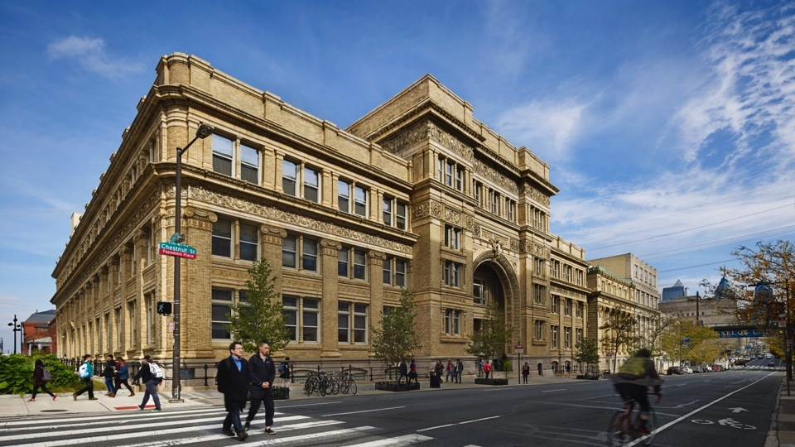
INFORMATION SESSION WILL START SHORTLY

Slide 3
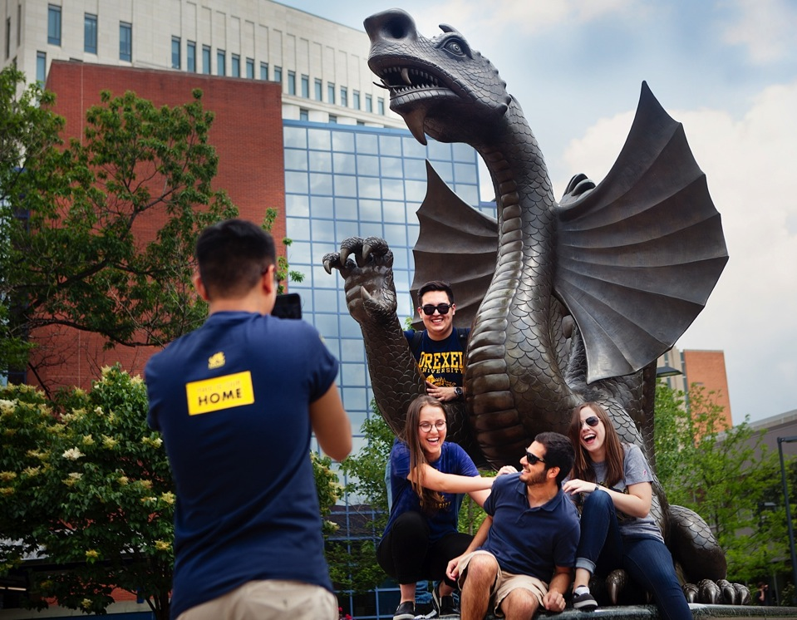
A comprehensive research University and experiential learning leader in Philadelphia, Pennsylvania.

Slide 4
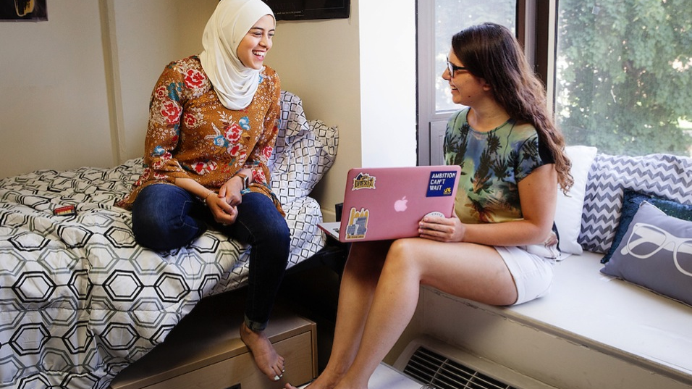
15,000+ total undergraduates
Students from 46 states and 127 countries
Alumni global network exceeds 150,000
Over 80 undergraduate majors
Student-to-faculty ratio 11:1
Median class size of 19 students
Source: 2018 Census
Notes:
Residence hall room in Towers building

Slide 5
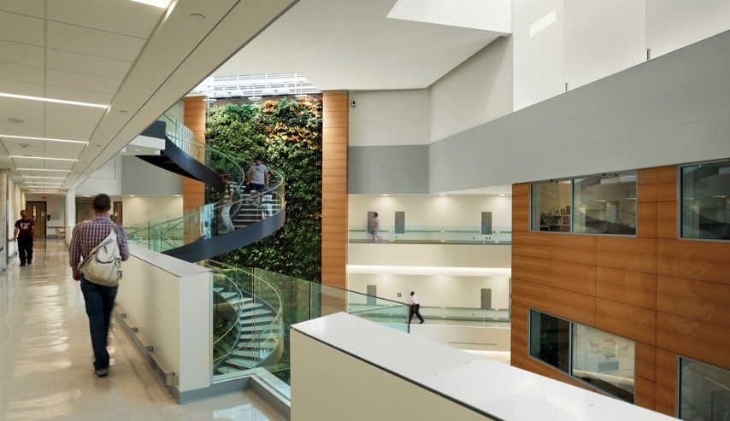
College of Arts & Sciences
School of Biomedical Engineering, Science
and Health Systems
LeBow College of Business
College of Computing & Informatics
School of Economics
School of Education
College of Engineering
Close School of Entrepreneurship
Kline School of Law
Westphal College of Media Arts & Design
College of Medicine
College of Nursing and Health Professions
Pennoni Honors College
Goodwin College of Professional Studies
Dornsife School of Public Health
Drexel offers combined and accelerated degree programs.
Notes:
Biowall in the P. Integrated Sciences Building

Slide 6
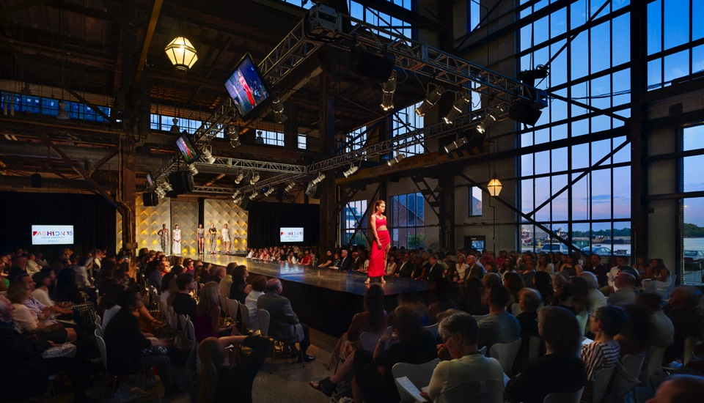
Redefine the classroom.
^{#futuredragons}
Notes:
Drexel Fashion Show URBN Outfitters HQ

Slide 7


Time well spent
5-year curriculum
4-year curriculum
Notes:
Most Gateway graduates select the one co-op 4-year curriculum, so they can graduate in the same amount of time as other international students who gain direct admission and select the three co-op 5-year curriculum.

Slide 8

The Steinbright Career Development Center
Prepare for the real world with COOP 101
Explore a potential career
Network with world leaders of today
Enhance the classroom dynamic
Comprehensive career services
Create a stand-out résumé
Refine interview skills
Build a foundation for graduate studies
Drexel’s cooperative education program is one of the largest of its kind.

Slide 9

96%
.
88%
92%
Source: http://drexel.edu/about/outcomes/
^{#futuredragons}
Notes:
A recent survey says that, 96% of our graduates are working in or attending professional schools; 89% of them are in fields related to or closely related to their chosen field of study of study and for those who are working full-time,
92% of them are happy!
Average salary is $59,000 one year after graduation which is 18% over the national average!
Average salary from 1 year out survey

Slide 10
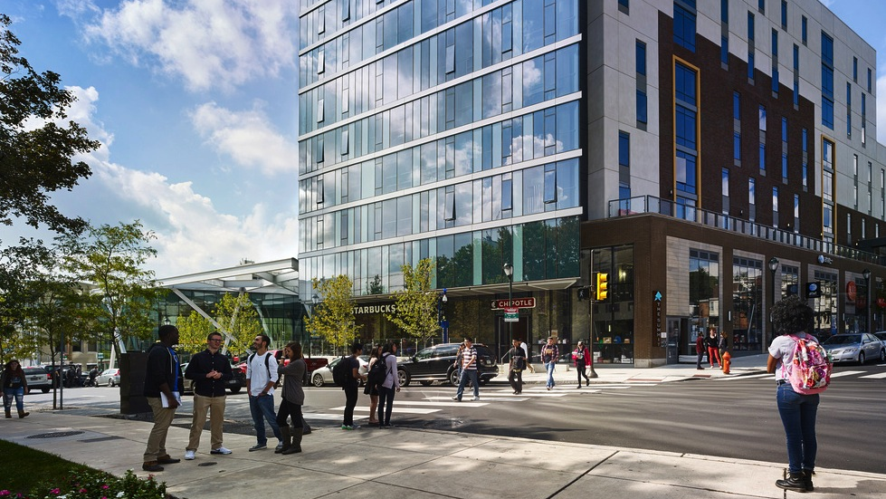
A City Within a City
Experience Division I athletics
Grab a quick bite at a food truck
Catch one of the Drexel Concert Series
Join one of our 350+ student organizations
Challenge new ideas in the Honors Program
Form a residence hall living community
“The most civically engaged university in the country” – President John A. Fry

Slide 11
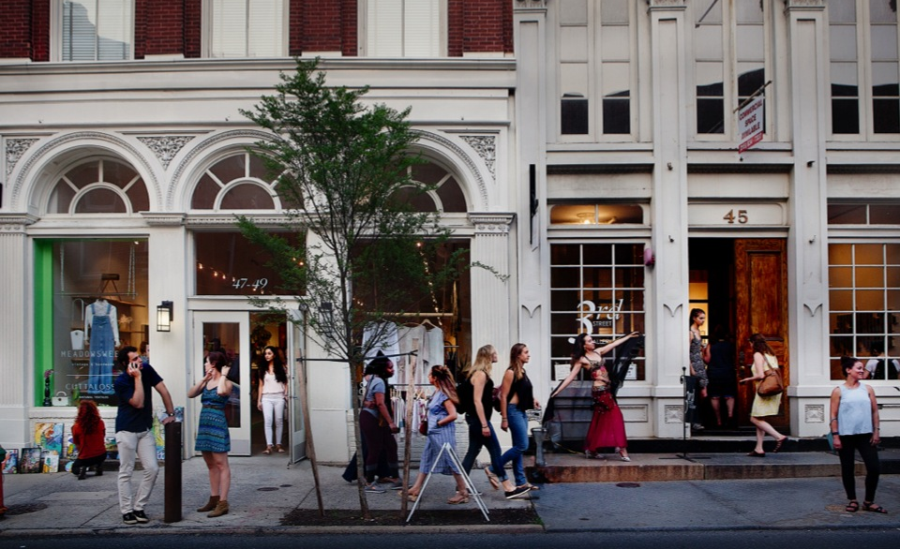
A Revolutionary Town
Visit world-class museums and parks
Spend the fall with the Philadelphia Eagles
Celebrate history at Independence Mall
Mentor Philly elementary school students
Experience Reading Terminal Market
View the local art scene on First Fridays
Philadelphia is home to over 250,000 college students.

Slide 12
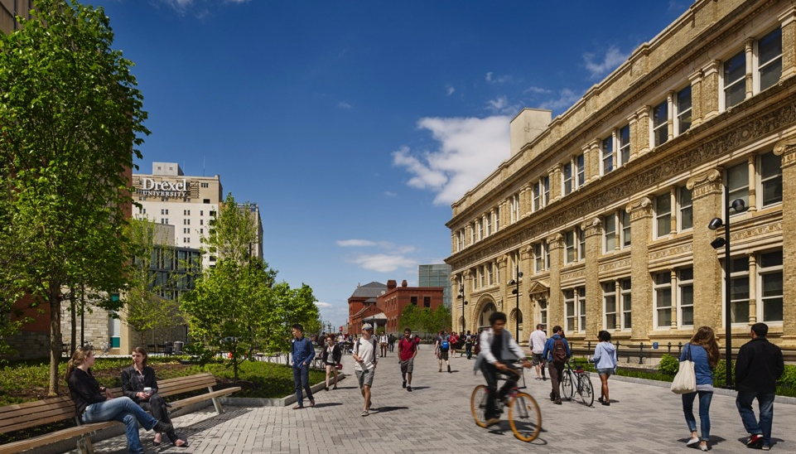
A Complete Process
Apply with the Common Application or Coalition Application
Submit the application fee
Submit high school and/or college transcripts
Complete the personal essay
Provide two letters of recommendation
Submit any required supplemental material
Optional – SAT/ACT
Transfer students have different requirements for a completed application.
Visit drexel.edu/undergrad to learn more.
Notes:
Drexel Campus – Pearlman plaza.

Slide 13
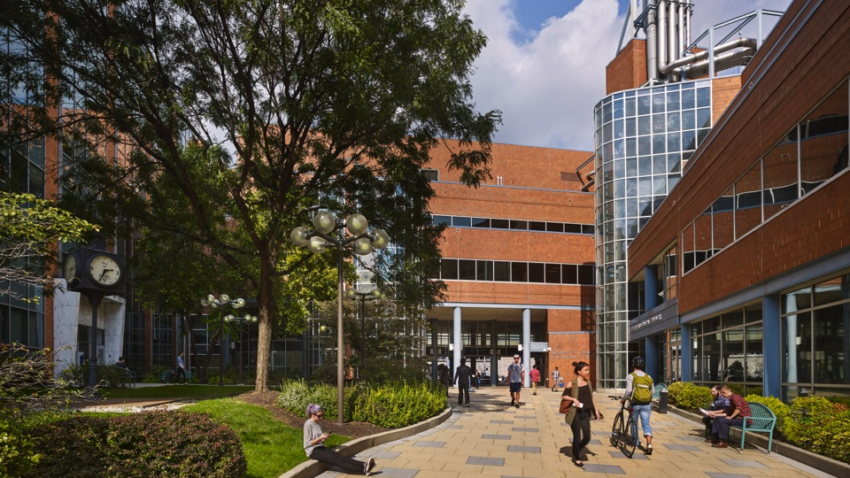
Investing in a Drexel Education
Financing is a partnership
Partners include:
Federal government
Drexel University
Students and families
A two-step process
Submit the CSS Profile and FAFSA
100% of 2020 First-Year Students received gift aid from Drexel
Tuition $54,766
Fees $2,405
Room and Board $16,488
Average financial aid package
$33,623
Includes only grant and scholarship awards from federal, state, and institutional sources for first-year
students who received financial aid.
Notes:
Drexel Campus

Slide 14
Investing in a Gateway Experience
2021-2022
Tuition $31,653
Fees $3,395
Room and Board $15,783
Although there is no financial aid available to students in Gateway, students are considered for merit-based scholarships once they matriculate. These scholarships are based largely on their Gateway GPA. Graduates may also submit the CSS Profile for need-based aid.
Notes:
Drexel Campus

Slide 15
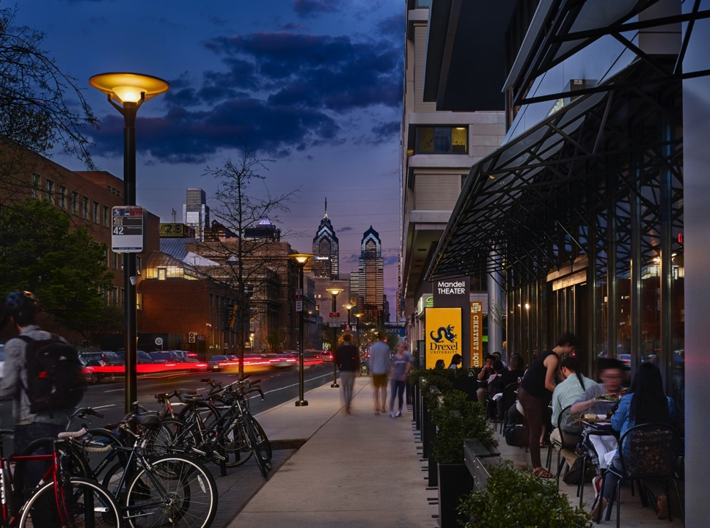
First-Year Admission Deadlines
1
15
15
15
1
Nov
Nov
Jan
Feb
May
Applications
Early Decision &
Early Action
CSS Profile
Early Decision & Early Action
Applications
Regular
Decision
Deposits
Early Decision
CSS Profile
Regular Decision
FAFSA Priority Submission Deadline
Deposits
Early Action & Regular Decision
Two-step process: The CSS Profile and FAFSA are required for the most financial aid.

Slide 16
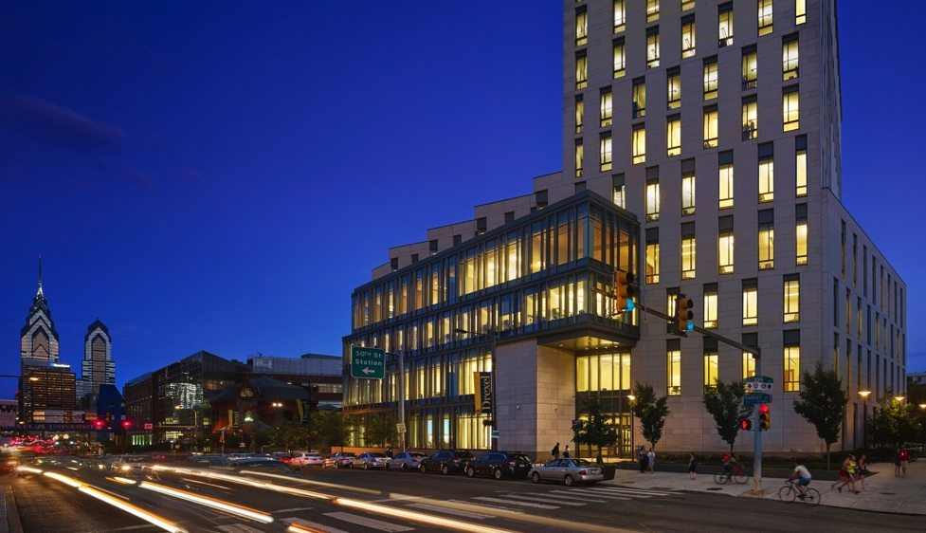
Transfer Admission Deadlines
15
15
15
One month prior to term
April
Nov
Feb
Priority
Fall Term
(September) Applications
Rolling
Until Sept 1
Winter Term
(January) Applications
Spring Term
(April)
Applications
CSS Profile
Due
After all deadlines pass, Drexel reviews transfer applications on a rolling basis.

Slide 17
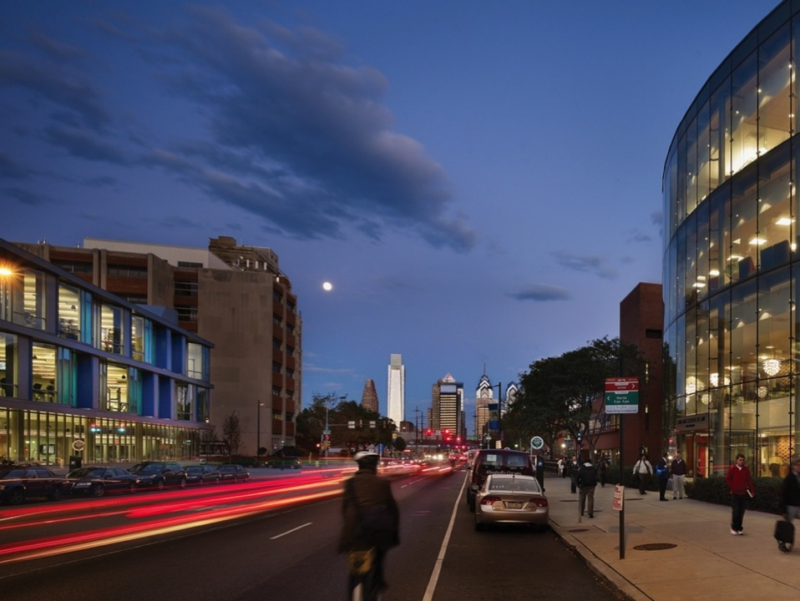
Gateway Admission Deadlines
15
31
1
15
July
July
Nov.
Nov.
Winter
(January) Confirmation
Fall
(September) Application
Fall
(September) Confirmation
Winter
(January)
Application

Slide 18
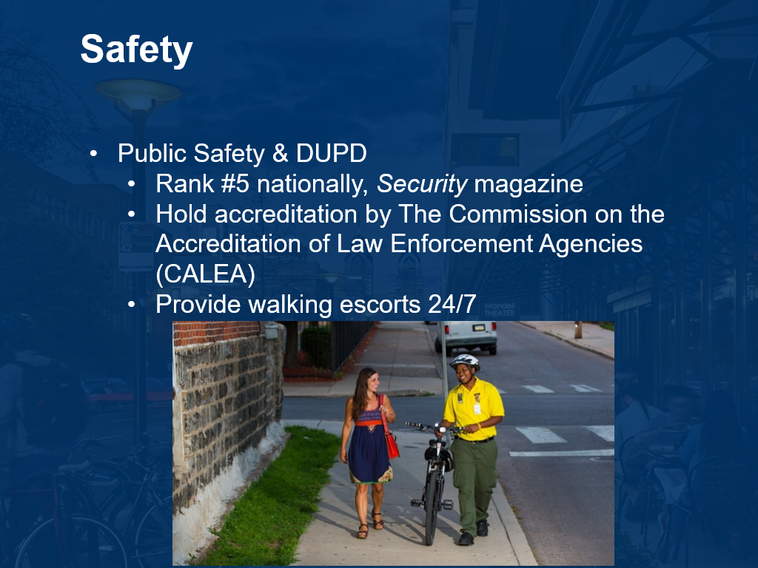

Slide 19
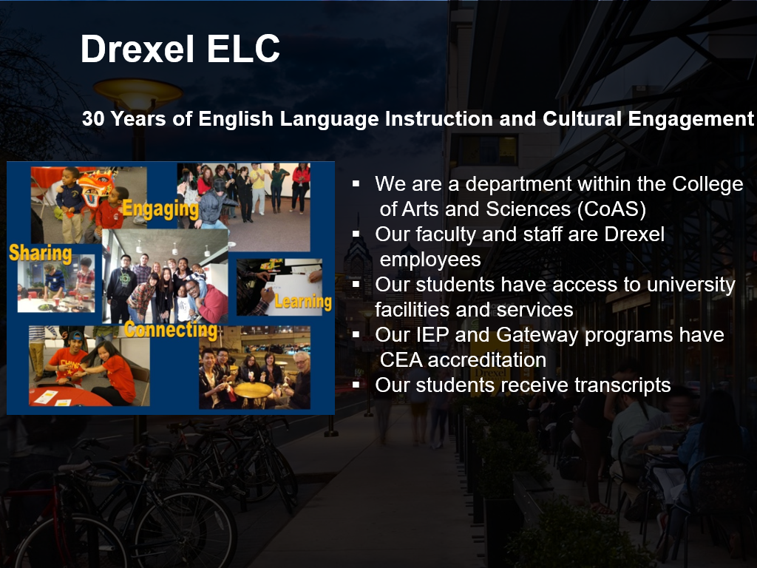

Slide 20
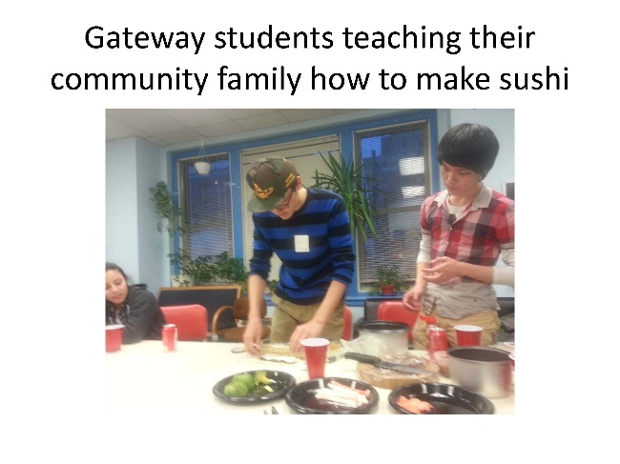
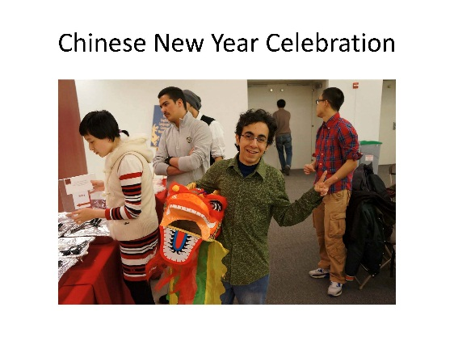
What is Gateway?
An undergraduate conditional admission program to Drexel University
2-4 terms of study that include:
    Intensive academic English
    University credit courses
    Academic advising
    Cultural and leisure activities

Slide 21
Program Courses 2021-2022
Fall | Winter | Spring | Summer
Academic Listening/Speaking and Writing/Grammar 15.0 hours | Academic Listening/ Speaking 7.5 hours | Gateway Writing for Chemistry 6.0 hours | Gateway Support for Humanities 6.0 hours
Reading/Vocabulary 6.0 hours | Reading/Vocabulary 6.0 hours | Skills for College Success 3.0 hours | Special Topic 3.0 hours
 | University courses: Math ESL-110 6-7 credits total | University courses: Math CHEM-201 ESL 180 8-9 credits total | University courses: Math and/or Humanities 6-12 credits total
Extracurricular activities | Extracurricular activities | Extracurricular activities | Extracurricular activities
Notes:
Thre is flexibility with the credit course curriculum.

Slide 22
Progress in Gateway
Students are required to show steady progress in ALL courses.
For English Language Center courses, they must:
Achieve final grade of 75% (C) in all courses
Satisfy attendance requirements to maintain I-20 status
For Drexel courses, they must:
Achieve a minimum 2.00 GPA (C) IN EACH COURSE
Achieve a 2.50 or 2.75 cumulative GPA by the end of the program, depending on the selected major
If any of the above criteria are not met, students will be allowed ONE term to improve (a probationary term).
Students not meeting progression criteria in the next term may be advised out of the program.

Slide 23
Drexel Matriculation Requirements
Complete at least through the Spring quarter
And
Achieve cumulative GPA of 2.50 (C+/B-) for non-STEM majors or 2.75 (B/B-) for STEM majors in Drexel University courses and 75% (C) in English Language Center courses
And
Obtain a letter of recommendation from the ELC

Slide 24
How to Apply
Students who apply for direct admission to the university with the Common Application (by January 15) may be referred to Gateway.
Students who apply directly to Gateway with the Slate application (by July 15 or November 1) on the ELC website do not need to submit letters of reference or an essay.

Slide 25
How to Qualify for Gateway
Students must meet eligibility requirements for their major of choice.
  Drexel does a holistic review.
Students need
  TOEFL 53 or IELTS 5.0 for Fall entry (currently accepting Duolingo 80)
  TOEFL 62 or IELTS 5.5 for Winter entry (currently accepting Duolingo 90)
  We can also offer our Versant English Placement Exam for admission

Slide 26
Housing
Gateway students can live on campus or off campus.
To live in a residence hall, students must register for all terms, from September/January to June.
A meal plan is required.

Slide 27
Gateway Graduates
95% 1st year retention
3.27 Cum GPA
88% Graduation rate
≈10% go on to graduate programs at Drexel. Many others go on to graduate programs at other institutions.
Two Gateway graduates have gone on to do PhD programs at Drexel.

Slide 28
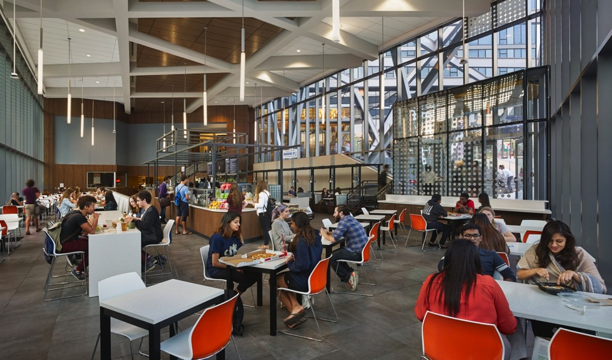
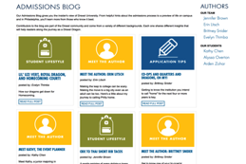
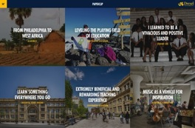

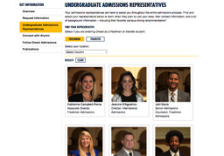

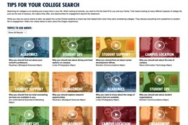

Connect with Dragons
Admissions Blog
@DrexelAdmission
PaperClip
Admissions
Representatives
International
(WeChat)
College Search Tips
Notes:
. Urban eatery

Slide 29
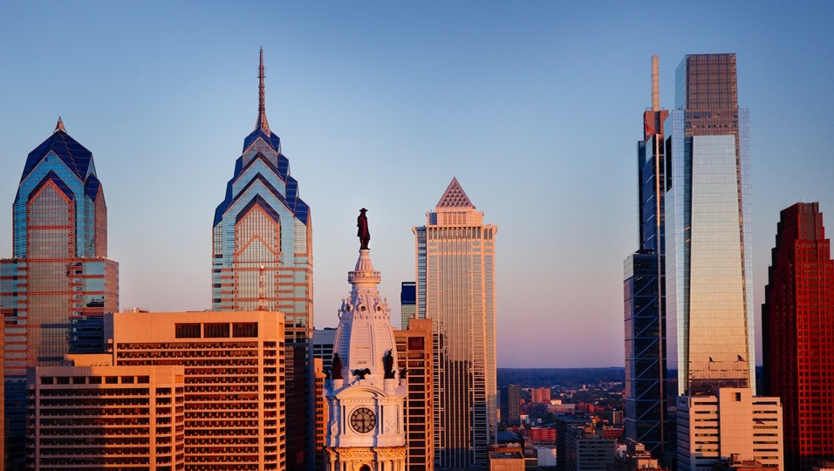

_{Travis E. Harman}
Associate Director, ELC Programs
215-895-6705 teh36@drexel.edu WeChat: TravisHarman2019
^{#futuredragons}
Notes:
Philly

